Slide 1
E-Commerce Data Analytics
By
Ayush Namdeo

Slide 2
Overview of the project
An international e-commerce company based in the USA wants to discover key insights from their customer database. They want to use some of the most advanced machine learning techniques to study their customers. The company sells electronic products.
The dataset used for model building contained 10999 observations of 12 variables.
The project is divided into 4 problem statements. Each of the problem is unique.
Used Python programming language to solve the problem statements.

Slide 3
Problem Statements
Problem Statement 1:- Build various classification models like Logistic Regression, Support Vector Machines, Random Forests, and XGBoost Techniques to predict if the shipments have reached the customer on-time or not.
Problem Statement 2:- Use Advance Visualization to illustrate illustrate if the shipments have reached on-time for the customers who have the best customer rating, the best customer score, made recurring orders and high payments.
Problem Statement 3:- Create a customer segmentation using clustering algorithm of the customers to whom the shipments are not reaching on time. Use only delayed customers data for clustering.
Problem Statement 4:- Do a Sentiment analysis(Positive or Negative) of the competitors: Amazon India, Flipkart , and Snapdeal . Use tweets to perform the analysis.

Slide 4
Data Description
Variable | Description
ID | ID Number of Customers.
Warehouse block | The Company have big Warehouse which is divided in to block such as A,B,C,D,E.
Mode of shipment | The Company Ships the products in multiple way such as Ship, Flight and Road.
Customer care calls | The number of calls made from enquiry for enquiry of the shipment.
Customer rating | The company has rated from every customer. 1 is the lowest (Worst), 5 is the highest (Best).
Cost of the product | Cost of the Product in US Dollars.
Prior purchases | The Number of Prior Purchase.
Product importance | The company has categorized the product in the various parameter such as low, medium, high.
Gender | Male and Female.
Discount offered | Discount offered on that specific product.
Weight in gms | It is the weight in grams.
Reached on time | It is the target variable, where 1 Indicates that the product has NOT reached on time and 0 indicates it has reached on time.

Slide 5
Data Preparation
The dataset having 10999 observations with 12 variables for building the model.
The ID variable contain the unique number and also corresponded with rows number so it was removed.
The variable names are edited for better understanding.
All the categorical variable converted into numeric variable.
The dataset was checked for missing values. There were no missing values.

Slide 6
Data exploration
The shipments that were not delivered on-time were indicated as 1 and shipments that were delivered on-time is indicated as 0.
The target variable had 6563 shipments didn’t reach on-time and while 4436 shipments that reached on-time.
From that dataset we observed the company had an delayed delivery rate of 59.66 % as compared to on-time delivery rate of 40.33 % .
Average order value was 210.19 US Dollars. It is the average amount a customer ends up spending per transaction.

Slide 7
Data Exploration
Maximum no. of customer in dataset had prior purchase is 3 products. and minimum no. of customer in dataset had prior purchase is 8 products.
Majority of the customer rated as 3 which is received their order on-time.
Majority of products were of low importance.
Most activity from the F block of the warehouse.
A large share of deliveries were done by ships.
Maximum no. of customer in dataset made 4 calls to customer care.

Slide 8
Problem Statement 1:- Build various classification models like Logistic Regression, Support Vector Machines, Random Forests, and XGBoost Techniques to predict if the shipments have reached the customer on-time or not.

Slide 9
Problem statement 1 and insights
Logistics Regression
Model Name | Descriptions | Accuracy
Model1 | Included all variables | 63.75%
Model2 | Included only most weighted feature | 64.36%
Important features:- Customer_care_calls,Customer_rating,Cost_of_the_product, Prior_purchases, Discount_offered, Weight_in_gms.

Slide 10
Problem statement 1 and insights
Support Vector Machine
Model Name | Descriptions | Accuracy
Clf | Included all variables | 65.5%
clf2 | Included only most weighted feature | 65.66%
Important features:- Customer_care_calls,Customer_rating,Cost_of_the_product, Prior_purchases, Discount_offered, Weight_in_gms.

Slide 11
Problem statement 1 and insights
Random Forest
Model Name | Descriptions | Accuracy
regressor | Included all variables | 65.27%
regressor1 | Included only most weighted feature | 66.42%
Important features:- Customer_care_calls,Customer_rating,Cost_of_the_product, Prior_purchases, Discount_offered, Weight_in_gms.

Slide 12
Problem statement 1 and insights
XGBoost
Model Name | Descriptions | Accuracy
xgmodel | Included all variables | 67.78%
xgmodel2 | Included only most weighted feature | 68.93%
Important features:- Customer_care_calls,Customer_rating,Cost_of_the_product, Prior_purchases, Discount_offered, Weight_in_gms.
Insights:- Model gave an accuracy of 68.93 % which is significantly better than the performance of other models – Logistic regression, Support Vector Machines, and Random Forest.

Slide 13
Problem Statement 2:- Use Advance Visualization to illustrate illustrate if the shipments have reached on-time for the customers who have the best customer rating, the best customer score, made recurring orders and high payments.

Slide 14
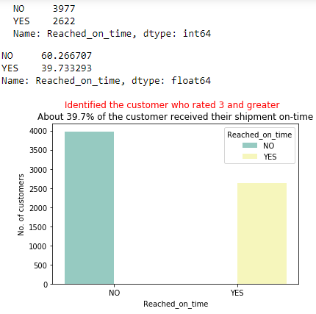
Problem statement 2 and Observations
Good customer rating:-We just the customer who rated 3 or greater than 3 using query function. We visualized the data with respect the target variable.Good_rating contained 6599 observation from original 10999 observation.
Observation
Here 39.7 % shows reach their shipment on-time which is very low.
And 60.26% shows not reach their shipments on-time but they also rated as 3 or greater
Note-We just change the values of target variable 0 is denoted by Yes which is reach on-time and 1 is denoted by No which not reach on-time.

Slide 15
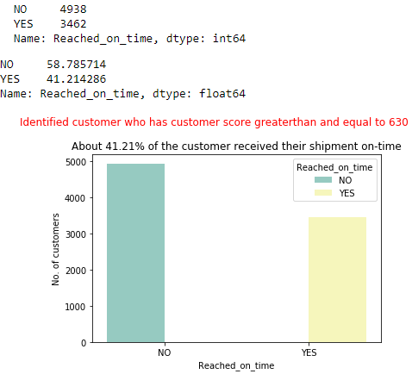
Problem statement 2 and Observations
Good customer score:- First we calculated the average value and we found the $210. Customer score calculated by multiplying the average value and prior purchase of each customer. Then we get the score of customers using filter which is greater than or equal to median_score of customer score. Then we get the 8400 observations out of 10999 observations.
Observations
Here 41.21 % shows reach their shipment on-time.
And 58.78% shows not reach their shipments on-time but they have good customer _score
Note-We just change the values of target variable 0 is denoted by Yes which is reach on-time and 1 is denoted by No which not reach on-time.

Slide 16
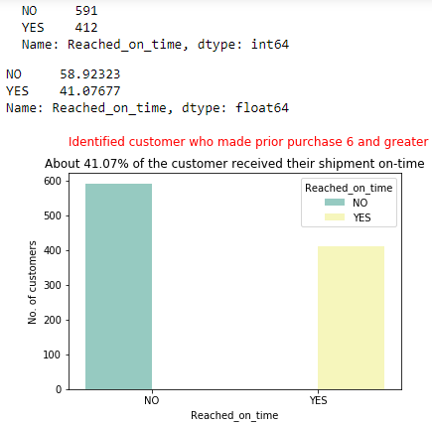
Problem statement 2 and Observations
Make recurring orders:- Identified customer who made prior purchase 6 or greater than 6 so we get 1003 observations from 10999 observation using query function.
Here 41.07 % shows reach their shipment on-time.
And 58.92% shows not reach their shipments on-time but they have made greater than 6 prior purchase.
Observations
Note-We just change the values of target variable 0 is denoted by Yes which is reach on-time and 1 is denoted by No which not reach on-time.

Slide 17

Problem statement 2 and Observations
Highest payment buyers:- Identified the customer who made payment greater than and equal to median_value(214$) of cost of product using query function. So we get 5544 observations from 10999 observations.
Observations
Here 43.43 % shows reach their shipment on-time.
And 56.56% shows not reach their shipments on-time but they have made highest payments.
Note-We just change the values of target variable 0 is denoted by Yes which is reach on-time and 1 is denoted by No which not reach on-time.

Slide 18
Problem Statement 3:- Create a customer segmentation using clustering algorithm of the customers to whom the shipments are not reaching on time. Use only delayed customers data for clustering.

Slide 19

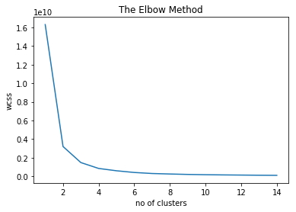
Problem statement 3 and Observations
K-Means Clustering
Observation
From the elbow chart, it is observed that WCSS significantly decreases after 2 . Hence the optimal number of clusters was chosen as 2.

Slide 20
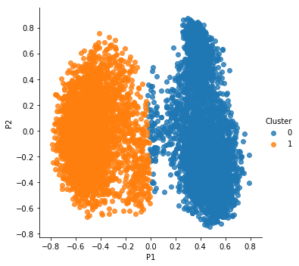
Problem statement 3 and Observations
Observation
K-means clustering with 2 clusters of sizes 3411,3152.
Both the clusters looks similar in values in column except discount_offered and Weight_in_gms.
Discount_offered and Weight_in_gms this two is significant parameter.

Slide 21
Problem Statement 4:- Do a Sentiment analysis(Positive or Negative) of the competitors: Amazon India, Flipkart , and Snapdeal . Use tweets to perform the analysis.

Slide 22

Problem statement 4 and insights
Problem Statement :- Do a Sentiment analysis(Positive or Negative) of the competitors: Amazon India, Flipkart , and Snapdeal . Use tweets to perform the analysis.
Data was fetch from Twitter API.Using Tweepy package in Python.
We fetch 2000 tweets from each site- AmazonIN, Flipkart, Snapdeal. But we search for Snapdeal so we get only 1199 observations.
Then we process the data which is remove the Punctuation, Number, Symbols, Emojis and Retweet data.

Slide 23
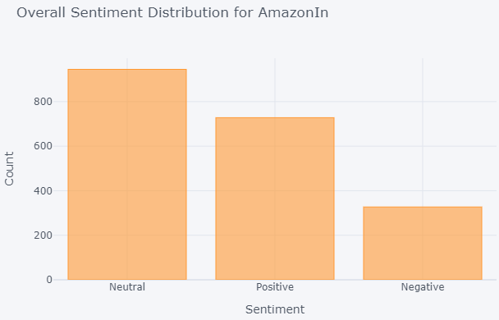
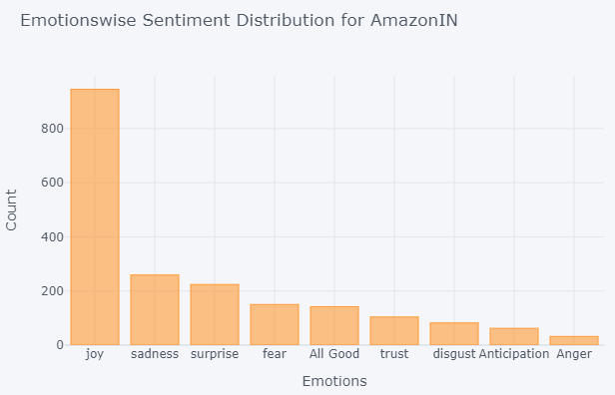
Amazon India
Observations
Customers are Joy and trust the brand overall impression is good about AmazonIndia.
Most of the customer feel joy as compare to Flipkart and Snapdeal.
Overall positive sentiment rate is good.

Slide 24
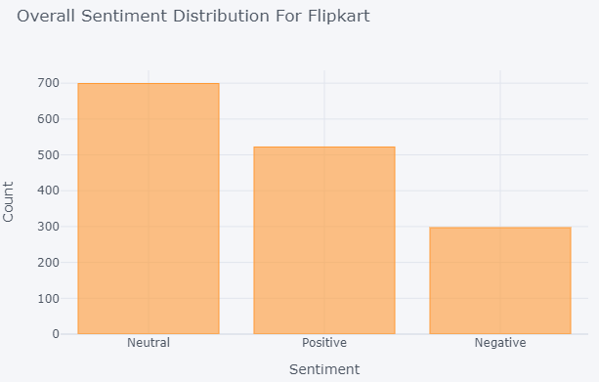
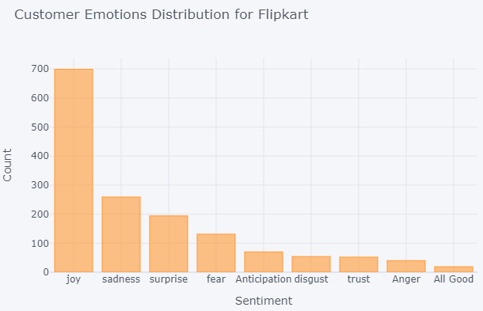
Flipkart
Observations
Customers are Joy and trust the brand about Flipkart.
Sadness people are more who is not happy as compare to AmazonIndia or Snapdeal.
Overall positive sentiment is good.

Slide 25
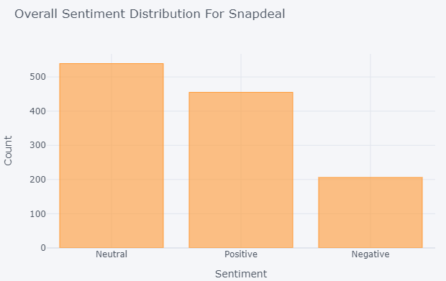
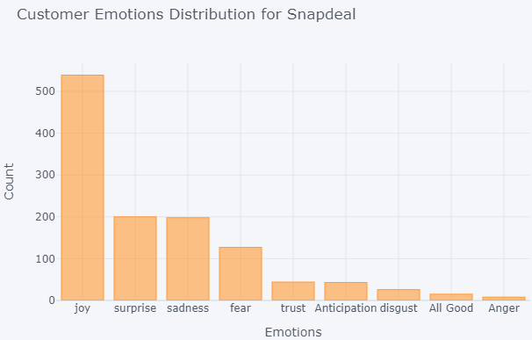
Snapdeal
Observations
Customers are Joy and trust the brand about Snapdeal.
Sadness and Surprise is same in Snapdeal.
Overall positive sentiment is good.

Slide 26

Thank You

